Slide 1
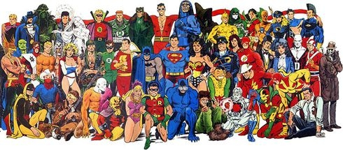
UNIT TWO: THE COMIC BOOK SUPERHERO

Slide 2
Agenda:
Understanding Comics, McLeod
Historical Context; Influences
Anti-Comic Crusade
The Superhero Genre
Superhero Monomyth
Superhero Monomyth limitations

Slide 3
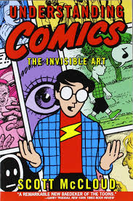
Scott Mcleod, Understanding Comics
Unpacks the idea of comics as “childish medium”
Wants comics to be looked as a mature art form, worthy of serious critical evaluation
Comic book medium is narrowly defined
“sequential art” –Will Eisner (too broad)

Slide 4
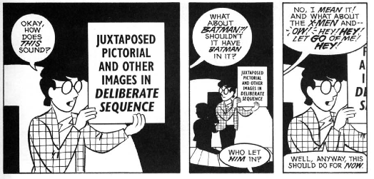
McLeod: Proper Definition of Comics

Slide 5
Historical Context: “The Funnies”
Modern comics began at the turn of the 20th century
Comic books first emerged as a distinct medium in the 1930’s
precursor to comic books: the newspaper comic strip (1890’s)
become known as “comic strips” or “funnnies”
Then its offspring was the magazine format which became known as the comic

Slide 6
Influences of Comic Books
Influences:
newspaper comic strips
Pulp magazines
Printed on cheap paper
Popular during the early decades of the 20th century

Slide 7
Comic Book: A Misnomer
Comics are not books; and are often not comical (Wright)
They explore various kinds of popular genres including, adventure, horror, mystery, crime, romance, the Western, humour
Most closely associated with superheroes
Contributes to their classification as “junk”; insignificant, immature medium
low-brow status” but not junk!
They have much to say; meaning to convey

Slide 8
Graphic Novel
Long form of the comic, published as a book or series
A coherent story
Wide variety of subject matter (i.e., political, social criticism, personal reflections or philosophies, humour)

Slide 9
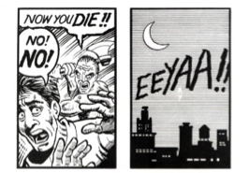
Gutters & Transitions
Reader participation in comic genre is active, voluntary, and powerful
Comics make use of and rely on the reader’s imagination
Through act of “Closure” (67)
What our (the reader’s) imagination does to fill the gaps between each comic panel
The space between each comic panel is called “the gutter” (66)

Slide 10
Rene Descartes: Wax Experiment
example Page 69, McLeod
A --------------BLACK BOX-----------------B
We make links or connections between one state of affairs to another
We think A causes B; but there can be lots of possibilities; more going on in the black box
TAKE HOME POINT: More going on than we imagine
Interplay between truth and perception

Slide 11
Faith or Hope vs Skepticism & Rationalism
Relying on sufficient evidence
This is a very skeptical approach to making choices, decisions, sense of things
Sufficient, reliable, evidence does not work in relation to superheroes
Relationship between science and religion
Descartes shifted it

Slide 12
Skepticism; Scientific Attitudes
Scientific attitudes are not appropriate to certain situations
The idea that don’t believe anything w/o sufficient evidence
Skepticism does not work in terms of the following:
Moral questions
Matters of the heart
Matters of social trust (i.e., not trusting a person until one builds enough evidence to trust the person)
These are the matters of Superheroes
This is why they are archetypes of our time
Skepticism does not work in the context of superheroes

Slide 13
The Big Picture; What’s Out There?
There is a whole lot more to the person than the person knows about
There’s always a partial appreciation / grasp of what is real
Arrogant to believe that what we know is a complete view
Sensory-based knowledge (input from five senses)
The world is fragmented and incomplete—we cannot perceive “the big picture”; reality as a coherent whole
We only know what we see, hear, touch, feel, taste
Anything beyond that is an act of faith

Slide 14
“I think therefore I am”
Are our senses reliable?
What about sensory illusions? (i.e., optical illusions, hallucinations, dreams that may fool us)
Decartes found doubt with the sensory-based knowledge theory (proved by sensory illusions)
The one thing he says exists beyond doubt, the only true thing is the idea of a self or an “I” (can be referred to as a mind, understanding, soul)

Slide 15
Anti-Comic Crusade
Frederic Wertham, M.D., Seduction of the Innocent
http://www.dreadfuldays.net/soti.html
The influence of comic books on youth
He is interested in investigating the psychological and psychosocial effects and conditioning through the comic book medium
The Anti-Comics Crusade:
http://www.lostsoti.org/TheAntiComicsCrusade.htm
1940 started but grew to prominence in 1948
Argument: comics is a widespread social phenomenon—has significant social influences on the individual

Slide 16
Superheroes
We live in the stories we tell ourselves. In a secular, scientific rational culture lacking in any convincing spiritual leadership, superhero stories speak loudly and boldly to our greatest fears, deepest longings, and highest aspirations. They’re not afraid to be hopeful, not embarrassed to be optimistic, and utterly fearless in the dark. They’re about as far from social realism as you can get, but the best superhero stories deal directly with mythic elements of human experience that we can all relate to, in ways that are imaginative, profound, funny, and provocative. They exist to solve problems of all kinds and can always be counted on to find a way to save the day. At their best, they help us confront and resolve even the deepest existential crises. We should listen to what they have to tell us.”
~Grant Morrison, SUPERGODS (2011, pp.xvii)

Slide 17
Superhero Genre
Genre defined: a genre is a privileged story form, “part of a limited number of story forms that have been refined into formulas because of their unique social and/or aesthetic qualities” –Thomas Schatz

Slide 18
Superhero defined
A heroic character with a selfless, pro-social mission; with superpowers—extraordinary abilities, advanced technology, or highly developed physical, mental, or mystical skills; who has a superhero identity embodied in a codename and iconic costume, which typically expresses his biography, character, powers, or origin (transformation from ordinary person to superhero); and who is generally distinct, i.e., can be distinguished from characters of related genres (fantasy, science fiction, detective, etc.) by a preponderance of generic conventions. Often, superheroes have dual identities, the ordinary one of which is usually a closely guarded secret.” –Peter Coogan

Slide 19
3 Key Conventions of the Superhero Genre (MPI Elements)
1. Mission
Champions of the oppressed
Fight evil and injustice
The mission is selfless and prosocial
2. Powers
Super strength; super speed, super –leaping, invulnerable to destruction
3. Identity
Codename and costume (2 key elements)
Codename also associated with secret identity

Slide 20
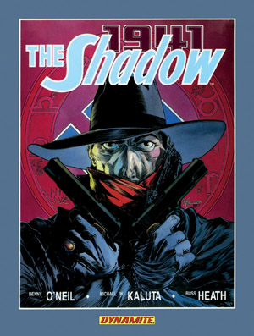

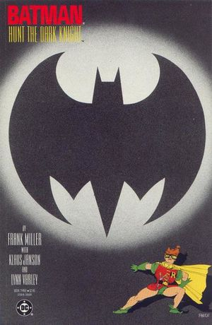
Icons

Slide 21
Evolution of the Superhero Genre
1. Golden Age (1938-1956)
2. Silver Age (1956-1971)
3. Bronze Age (1971-1980)
4. Iron Age (1980-enddate is difficult to determine –could be 1987 or even 1990’s)
5. Renaissance Age (1987-now)

Slide 22
Superhero Monomyth
“A community in a harmonious paradise is threatened by evil; normal institutions fail to contend with this threat; a selfless superhero emerges to renounce temptations and carry out the redemptive task; aided by fate, his decisive victory restores the community to its paradisiacal condition; the superhero then recedes into obscurity.”
Lawrence & Jewett, The Myth of the American Superhero

Slide 23
American Heroic Monomyth
American Monomyth (Archetypal plot formula):
A community in a harmonious paradise is threatened by evil; normal institutions fail to contend with this threat; a selfless superhero emerges to renounce temptations and carry out the redemptive task; aided by fate, his decisive victory restores the community to its paradisiacal condition; the superhero then recedes into obscurity. –
Lawrence & Jewett, The Myth of the American Superhero

Slide 24
American Heroic Monomyth cont’d
Classical monomyth (J. Campbell) focuses on rites of initiation, where as American monomyth foregrounds tales of redemption (i.e., Superman was born as a saviour figure)
Like Campbell’s classical hero, Superman’s birth and story of his origins are miraculous; he is reared by foster parents
Like Campbell’s classical hero, he regenerates his society as a whole
Draws from Judeo-Christian narratives of redemption—gives it a secularized spin
According to these stories, the “supersaviour” is a selfless servant; self-sacrificial; Christ-like figure
Christ’s credibility was eventually destroyed by the onset of scientific rationalism
Superman designed to embody both: hope in redemptive, divine powers; scientific abilities;

Slide 25
Monomyth Superhero Conventions --Lawrence and Jewitt, The Myth of the American Superhero
Disguised origins
Pure motivations
Redemptive tasks
Extraordinary powers
He originates outside the community he is called to save
Secret identity (by virtue of his unknown origins or alter ego)
Motivation is selfless drive to carry out justice---by virtue of this, the superhero’s revenge is justified
Shows restraint, withstands temptations
Renounces sexual fulfillment for the sake of the mission
Morally infallible
Superhero powers exempt him from blame
Non-violent-does not harm others
Physically cannot be injured fatally
He is always wise, sure, cool, and competent

Slide 26
Limitations of Superhero conventions
Superhero Monomyth based on simplistic moral binaries—between good and evil, virtue and villain
What are the implications of this monomyth?
It ignores (does not deal with) the contradictions and complexities of humanity
Ignores the moral ambiguities

